Slide 1
Some Python Plots

Slide 2
Introduction to Matplotlib
Matplotlib is a Python 2D plotting package which produces publication quality figures in a variety of hardcopy formats and interactive environments across platforms.
matplotlib is the primary scientific plotting library in Python.
It provides functions for making publication-quality visualizations such as line charts, histograms, scatter plots, and so on.
Visualizing your data and different aspects of your analysis can give you important insights, and we will be using matplotlib for all our visualizations.

Slide 3
Introduction to Matplotlib
When working inside the Jupyter Notebook, you can show figures directly in the browser by using the %matplotlib notebook and %matplotlib inline commands.
We recommend using %matplotlib notebook, which provides an interactive environment. Using %matplotlib inline can generate a plot. Try the following code:
%matplotlib notebook
import matplotlib.pyplot as plt
# Generate a sequence of numbers from -10 to 10 with 100 steps in between
x = np.linspace(-10, 10, 100)
# Create a second array using sine
y = np.sin(x)
# The plot function makes a line chart of one array against another
plt.title("Use %matplotlib inline")
plt.plot(x, y, marker="x"); plt.show()

Slide 4
Introduction to Matplotlib
%matplotlib inline
import matplotlib.pyplot as plt
# Generate a sequence of numbers from -10 to 10 with 100 steps in between
x = np.linspace(-10, 10, 100)
# Create a second array using sine
y = np.sin(x)
# The plot function makes a line chart of one array against another
plt.title("Use %matplotlib inline")
plt.plot(x, y, marker="x")
plt.show()

Slide 5
Introduction to Matplotlib
Matplotlib is a Python 2D plotting package which produces publication quality figures in a variety of hardcopy formats and interactive environments across platforms.
matplotlib is the primary scientific plotting library in Python. It provides functions for making publication-quality visualizations such as line charts, histograms, scatter plots, and so on.
Visualizing your data and different aspects of your analysis can give you important insights, and we will be using matplotlib for all our visualizations.
When working inside the Jupyter Notebook, you can show figures directly in the browser by using the %matplotlib notebook and %matplotlib inline commands.

Slide 6
Introduction to Matplotlib
We recommend using %matplotlib notebook, which provides an interactive environment
For example, this code produces a plot.
%matplotlib inline
import matplotlib.pyplot as plt
# Generate a sequence of numbers from -10 to 10 with 100 steps in between
x = np.linspace(-10, 10, 100)
# Create a second array using sine
y = np.sin(x)
# The plot function makes a line chart of one array against another
plt.plot(x, y, marker="x")

Slide 7
Introduction to Matplotlib
It can be used to create simple plots with just a few commands such as a histogram
import numpy as np
import matplotlib.pyplot as plt
x = np.random.randn(10000)
plt.hist(x, bins=50)
plt.show()

Slide 8
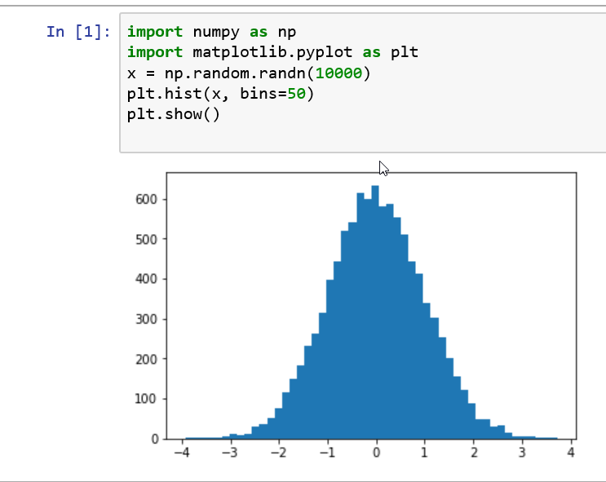
Introduction to Matplotlib

Slide 9
Introduction to Matplotlib
Package matplotlib.pyplot provides a MATLAB-like plotting framework
Package pylab combines pyplot with NumPy into a single namespace
Convenient for interactive work
For programming, it’s recommended that the namespaces be kept separate
import numpy as np
import matplotlib.pyplot as plt
x = np.arange(0, 10, 0.1)
y = np.sin(x)
plt.plot(x, y)
plt.show()
from pylab import *
x = arange(0, 10, 0.1)
y = sin(x)
plot(x, y)
show()

Slide 10
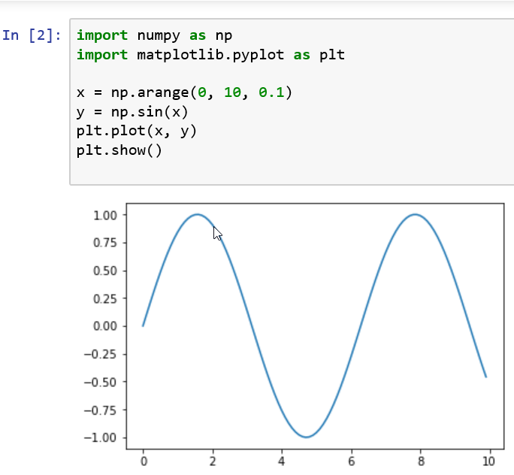
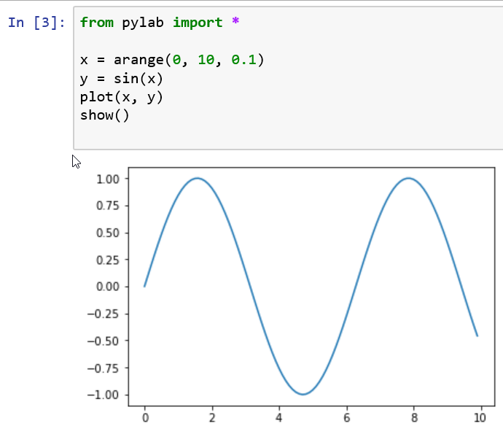
Introduction to Matplotlib

Slide 11
Basic Plots with Matplotlib
Next, we explore most common types of data visualizations: line graphs, bar charts, histograms, pies, and variations thereof.
matplotlib is a powerful toolbox that satisfies almost all our needs for 2D and some 3D plotting needs as well.
We will present different basic plots and what are they used for using matplotlib.
plot([1,2,3,4,4,3,2,1,3,2,2,1])
plot.show()

Slide 12
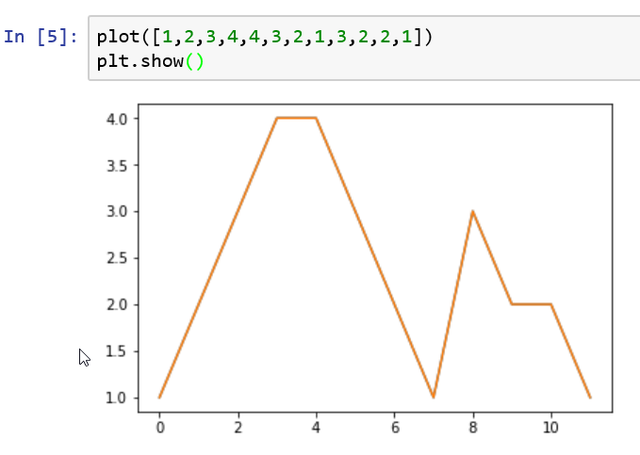
Basic Plots with Matplotlib

Slide 13
Basic Plots with Matplotlib
The basic plot in matplotlib contains the following elements:
x and y axes: These are both horizontal and vertical axes.
x and y tickers: These are little tickers denoting the segments of axes.
There can be major and minor tickers.
x and y tick labels: These represent values on particular axis.
Plotting area: This is where the actual plots are drawn.

Slide 14
Running Python from Command Prompt
To test, in the Python command line,
type the 1st example (3 lines plotting a straight line) in the Tutorial (see below)
plot() creates an object and outputs info on it
Not an error report
show() displays a figure
Close it to return from the command
C:\\>python
>>>from pylab import *
>>>plot([1,2,3,4])
>>>show()
>>>quit()

Slide 15
Documentation
Documentation page (links): http://matplotlib.org/contents.html
PyplotTutorial (8 pp.)
http://matplotlib.sourceforge.net/users/pyplot_tutorial.html
User’s Guide
http://matplotlib.org/users/
Refer to as needed
Cookbook / Matplotlib
http://matplotlib.org/api/cbook_api.html
Lots of good examples
Shows figure, link to page giving code and explanation

Slide 16
Documentation
Cyrille Rossant, Learning IPython for Interactive Computing and Data Visualization, Packt Publishing, 2013, 138 pages
Amazon $27, 4.5 on 8 reviews
matplotlib FAQ
http://matplotlib.sourceforge.net/faq/index.html
Using matplotlib in a python shell
http://matplotlib.sourceforge.net/users/shell.html
For performance, by default, matplotlib defers drawing until the end of the
But, to test things out interactively (in the shell), usually want to update after every command
Shows how to do this
Do it with IPython

Slide 17
Documentation
Examples
http://matplotlib.org/examples/
Just names under headings, but names are descriptive
The “What's new” page
http://matplotlib.org/users/whats_new.html
Every feature ever introduced into matplotlib is listed here under the version that introduced it
Often with a link to an example or documentation
Global Module Index: http://matplotlib.org/py-modindex.html
Documentation on the various modules
This and the next 2 are comprehensive
The Matplotlib API: http://matplotlib.sourceforge.net/api/
Documentation on the various packages
Pyplot documentation (142 pp.): http://matplotlib.org/api/pyplot_api.html

Slide 18
matplotlib.pyplot vs. pylab
Package matplotlib.pyplot provides a MATLAB-like plotting framework
Package pylab combines pyplot with NumPy into a single namespace
Convenient for interactive work
For programming, it’s recommended that the namespaces be kept separate
See such things as
import pylab
Or
import matplotlib.pyplot as plt
The standard alias
import numpy as np
The standard alias

Slide 19
Also
from pylab import *
Or
from matplotlib.pyplot import *
from numpy import *
You can use either
from pylab import *
Or
import matplotlib.pyplot as plt

Slide 20
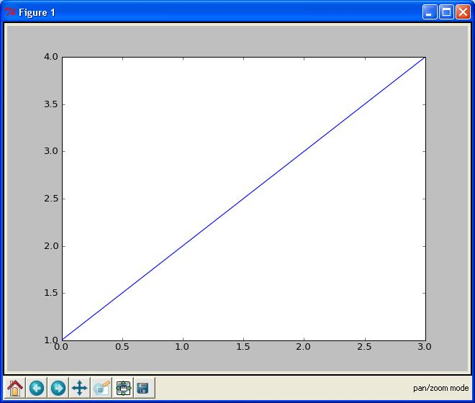
Batch and Interactive Use
In a script,
import the names in the pylab namespace
then list the commands
Example: file E:\SomeFolder\mpl1.py
from pylab import *
plot([1,2,3,4])
show()
Executing
E:\SomeFolder>mpl1.py
produces the figure shown
The command line hangs until the figure is dismissed (click ‘X’ in the upper right)

Slide 21
Matplotlib from the Shell
plot()
Given a single list or array, plot() assumes it’s a vector of y-values
Automatically generates an x vector of the same length with consecutive integers beginning with 0
Here [0,1,2,3]
To override default behavior, supply the x data: plot(x,y )
where x and y have equal lengths
show()
Should be called at most once per script
Last line of the script
Then the GUI takes control, rendering the figure

Slide 22
Matplotlib from the Shell
In place of show(), can save the figure to with, say,
savefig('fig1.png')
Saved in the same folder as the script
Override this with a full pathname as argument—e.g.,
savefig('E:\\SomeOtherFolder\\fig1.png')
Supported formats: emf, eps, pdf, png, ps, raw, rgba, svg, svgz
If no extension specified, defaults to .png

Slide 23
Matplotlib from the Shell
Using matplotlib in the shell, we see the objects produced
>>> from pylab import *
>>> plot([1,2,3,4])
[<matplotlib.lines.Line2D object at 0x01A3EF30>]
>>> show()
Hangs until the figure is dismissed or close() issued
show() clears the figure: issuing it again has no result
If you construct another figure, show() displays it without hanging

Slide 24
Matplotlib from the Shell
draw()
Clear the current figure and initialize a blank figure without hanging or displaying anything Results of subsequent commands added to the figure
>>> draw()
>>> plot([1,2,3])
[<matplotlib.lines.Line2D object at 0x01C4B6B0>]
>>> plot([1,2,3],[0,1,2])
[<matplotlib.lines.Line2D object at 0x01D28330>]
Shows 2 lines on the figure after show() is invoked
Use close() to dismiss the figure and clear it
clf() clears the figure (also deletes the white background) without dismissing it
Figures saved using savefig() in the shell by default are saved in
C:\Python27
Override this by giving a full pathname

Slide 25
Interactive Mode
In interactive mode, objects are displayed as soon as they’re created
Use ion() to turn on interactive mode, ioff() to turn it off
Example
Import the pylab namespace, turn on interactive mode and plot a line
>>> from pylab import *
>>> ion()
>>> plot([1,2,3,4])
[<matplotlib.lines.Line2D object at 0x02694A10>]
A figure appears with this line on it
The command line doesn’t hang
Plot another line
>>> plot([4,3,2,1])
[<matplotlib.lines.Line2D object at 0x00D68C30>]
This line is shown on the figure as soon as the command is issued

Slide 26
Interactive Mode
Turn off interactive mode and plot another line
>>> ioff()
>>> plot([3,2.5,2,1.5])
[<matplotlib.lines.Line2D object at 0x00D09090>]
The figure remains unchanged—no new line
Update the figure
>>> show()
The figure now has all 3 lines
The command line is hung until the figure is dismissed

Slide 27
Matplotlib in IPython
Recommended way to use matplotlib interactively is with ipython
In the IPython drop-down menu, select pylab

Slide 28
Matplotlib in IPython
IPython’s pylab mode detects the matplotlibrc file
Makes the right settings to run matplotlib with your GUI of choice in interactive mode using threading
IPython in pylab mode knows enough about matplotlib internals to make all the right settings
Plots items as they’re produce without draw() or show()
Default folder for saving figures on file
C:\Documents and Settings\⟨current user ⟩

Slide 29
More Curve Plotting
plot() has a format string argument specifying the color and line type
Goes after the y argument (whether or not there’s an x argument)
Can specify one or the other or concatenate a color string with a line style string in either order
Default format string is 'b-' ( solid blue line)
Some color abbreviations
b (blue), g (green), r (red), k (black), c (cyan)
Can specify colors in many other ways (e.g., RGB triples)
Some line styles that fill in the line between the specified points
- (solid line), -- (dashed line), -. (dash-dot line), : (dotted line)
Some line styles that don’t fill in the line between the specified point
o (circles), + (plus symbols), x (crosses), D (diamond symbols)
For a complete list of line styles and format strings,
http://matplotlib.sourceforge.net/api/pyplot_api.html#module-matplotlib.pyplot
Look under matplotlib.pyplot.plot()

Slide 30
More Curve Plotting
The axis() command takes a list
[xmin, xmax, ymin, ymax]
and specifies the view port of the axes
Example
In [1]: plot([1,2,3,4], [1,4,9,16], 'ro')
Out[1]: [<matplotlib.lines.Line2D object at 0x034579D0>]
In [2]: axis([0, 6, 0, 20])
Out[2]: [0, 6, 0, 20]
In [2]: show()

Slide 31
More Curve Plotting
Generally work with arrays, not lists
All sequences are converted to NumPy arrays internally
plot() can draw more than one line at a time
Put the (1-3) arguments for one line in the figure
Then the (1-3) arguments for the next line
And so on
Can’t have 2 lines in succession specified just by their y arguments
matplotlib couldn’t tell whether it’s
a y then the next y or
an x then the corresponding y
The example (next slide) illustrates plotting several lines with different format styles in one command using arrays

Slide 32
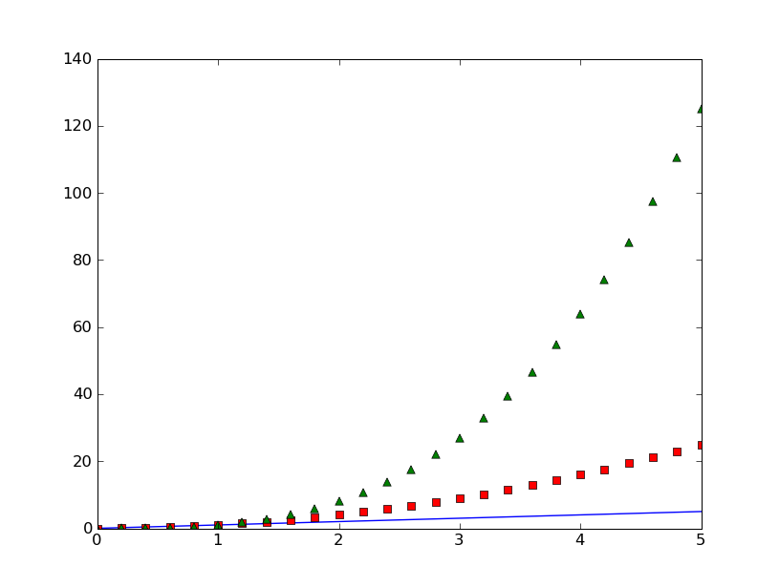
More Curve Plotting
In [1]: from pylab import *
t = arange(0.0, 5.2, 0.2)
plot(t, t, t, t**2, 'rs', t, t**3, 'g^')
Out[2]:
[<matplotlib.lines.Line2D object at 0x02A6D410>,
<matplotlib.lines.Line2D object at 0x02A6D650>,
<matplotlib.lines.Line2D object at 0x02A6D8D0>]

Slide 33
More Curve Plotting
Property | Values
alpha | The alpha transparency on 0-1 scale
antialiased | True | False - use antialised rendering
color | a matplotlib color arg
label | a string optionally used for legend
linestyle | One of -- : -. -
linewidth | a float, the line width in points
marker | One of + , o . s v x > < ^
markeredgewidth | The line width around the marker symbol
markeredgecolor | The edge color if a marker is used
markerfacecolor | The face color if a marker is used
markersize | The size of the marker in points
Lines you encounter are instances of the Line2D class
Instances have the following properties
alpha = 0.0 is complete transparency, alpha = 1.0 is complete opacity

Slide 34
More Curve Plotting
One of 3 ways to set line properties: Use keyword line properties as keyword arguments—e.g.,
plot(x, y, linewidth=2.0)
Another way: Use the setter methods of the Line2D instance
For every property prop, there’s a set_prop() method that takes an update value for that property
To use this, note that plot() returns a list of lines
The following has 1 line with tuple unpacking
line, = plot(x, y, 'o')
line.set_antialiased(False)

Slide 35
More Curve Plotting
The 3rd (and final) way to set line properties: use function setp()
1st argument can be an object or sequence of objects
The rest are keyword arguments updating the object’s (or objects’) properties
E.g.,
lines = plot(x1, y1, x2, y2)
setp(lines, color='r', linewidth=2.0)

Slide 36
Text
The text commands are self-explanatory
xlabel()
ylabel()
title()
text()
In simple cases, all but text() take just a string argument
text() needs at least 3 arguments:
x and y coordinates (as per the axes) and a string
All take optional keyword arguments or dictionaries to specify the font properties
They return instances of class Text

Slide 37
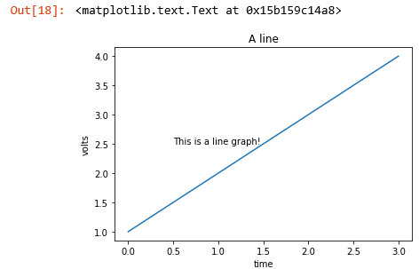
Text Example
from pylab import *
plot([1,2,3, 4])
xlabel('time')
ylabel('volts')
title('A line')
text(0.5, 2.5, 'This is a line graph!')

Slide 38
Text
The following font properties of Text instances can be set
Property | Values
alpha | The alpha transparency on 0-1 scale
color | a matplotlib color argument
fontangle | italic | normal | oblique
fontname | Sans | Helvetica | Courier | Times | Others
fontsize | a scalar, eg, 10
fontweight | normal | bold | light 4
horizontalalignment | left | center | right
rotation | horizontal | vertical
verticalalignment | bottom | center | top

Slide 39
Text
Three ways to specify font properties: using
setp
object oriented methods (We skip this)
font dictionaries
Use setp to set any property
t = xlabel('time')
setp(t, color='r', fontweight='bold')
Also works with a list of text instances—e.g.,
labels = getp(gca(), 'xticklabels')
setp(labels, color='r', fontweight='bold')

Slide 40
Text
All text commands take an optional dictionary argument and keyword arguments to control font properties
E.g., to set a default font theme and override individual properties for given text commands
font = {'fontname' : 'Courier',
'color' : 'r',
'fontweight' : 'bold',
'fontsize' : 11}
plot([1,2,3])
title('A title', font, fontsize=12)
text(0.5, 2.5, 'a line', font, color='k')
xlabel('time (s)', font)
ylabel('voltage (mV)', font)

Slide 41
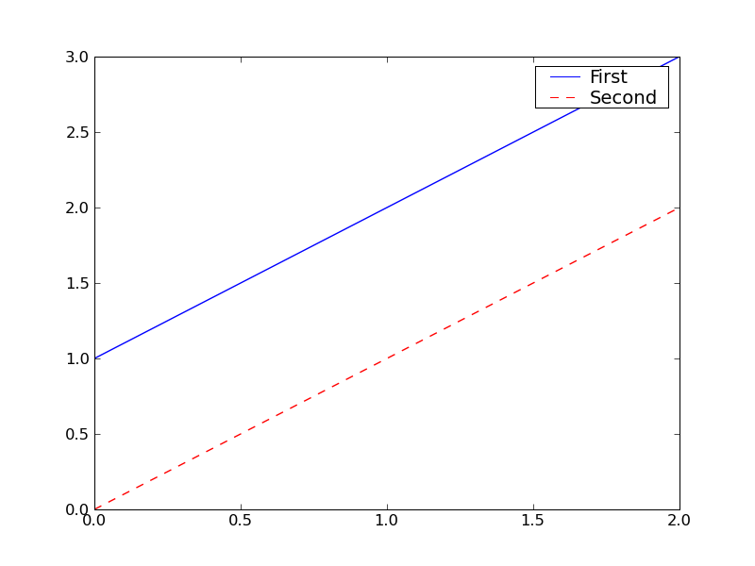
Legends
A legend is a box (by default in upper right) associating labels with lines (displayed as per their formats)
legend(lines, labels)
where lines is a tuple of lines, labels a tuple of corresponding strings
from pylab import *
lines = plot([1,2,3],'b-',[0,1,2],'r--')
legend(lines, ('First','Second'))
savefig('legend')

Slide 42
Legends
If there’s only 1 line, be sure to include the commas in the tuples
lengend((line1,), ('Profit',))
Use keyword argument loc to override the default location
Use predefined strings or integer codes
‘upper right’ 1
‘upper left’ 2
‘lower left’ 3
‘lower right’ 4
‘right’ 5
‘center left’ 6
‘center right’ 7
‘lower center’ 8
‘upper center’ 9
‘center’ 10
E.g., legend((line,), ('Profit',) , loc=2)

Slide 43
Bar Charts
Function bar() creates a bar chart
Most of the arguments may be either scalars or sequences
Say in […] what they normally are
Required arguments
left x coordinates of the left sides of the bars [sequence]
height height of the bars [sequence]

Slide 44
Bar Charts
Some optional keyword arguments
orientation orientation of the bars (‘vertical’ | ‘horizontal’)
width width of the bars [scalar]
color color of the bars [scalar]
xerr if not None,
generates error ticks on top the bars [sequence]
yerr if not None,
generates errorbars on top the bars [sequence]
ecolor color of any errorbar [scalar]
capsize length (in points) of errorbar caps (default 2) [scalar]
log False (default) leaves the orientation axis as is,
True sets it to log scale

Slide 45
Bar Charts
For the following example, need the following
yticks(seq, labels)
Make the ticks on the y axis at y-values in seq with labels the corresponding elements of labels
Without labels, number as per seq
xticks(seq, labels)
Same, but for the x axis
xlim(xmin, xmax)
The values on the x axis go from xmin to xmax

Slide 46
Bar Chart Example
from pylab import *
labels = ["Baseline", "System"]
data = [3.75, 4.75]
yerror = [0.3497, 0.3108]
xerror = [0.2, 0.2]
xlocations = array(range(len(data)))+0.5
width = 0.5
csize = 10
ec = 'r'
bar(xlocations, data, yerr=yerror, width=width,
xerr=xerror, capsize=csize, ecolor=ec)
yticks(range(0, 8))
xticks(xlocations+ width/2, labels)
xlim(0, xlocations[-1]+width*2)
title("Average Ratings on the Training Set")
show()
savefig('bar')

Slide 47
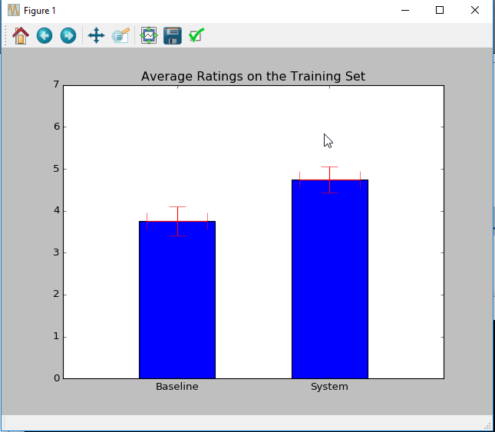

Slide 48
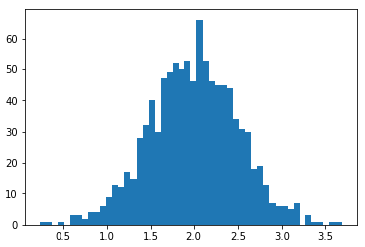
Histograms
hist(x, bins=n )
Computes and draws a histogram
x: a sequence of numbers (usually with many repetitions)
If keyword argument bins is an integer, it’s the number of (equally spaced) bins
Default is 10
from pylab import *
import numpy
x = numpy.random.normal(2, 0.5, 1000)
hist(x, bins=50)
show()
savefig('my_hist')

Slide 49
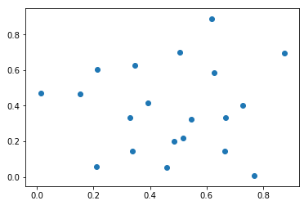
Scatter Plots
scatter(x, y )
x and y are arrays of numbers of the same length,
Makes a scatter plot of x vs. y
from pylab import *
N = 20
x = 0.9*rand(N)
y = 0.9*rand(N)
scatter(x,y)
show()
savefig('scatter_dem')

Slide 50
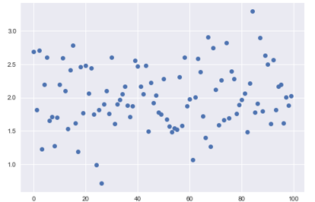
Dot Plots
from pylab import *
import numpy
x = numpy.random.normal(2, 0.5, 100)
plot(x,'o')
show()

Slide 51
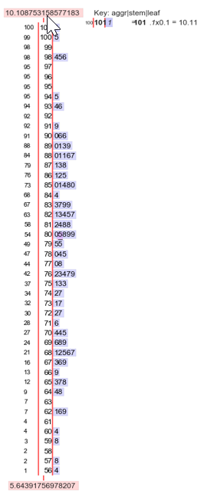
Stem-and-Leaf Plots
!pip install stemgraphic
import pandas as pd
import stemgraphic
from pylab import *
import numpy
x = numpy.random.normal(8, 1, 100)
y = pd.Series(x)
fig, ax = stemgraphic.stem_graphic(y)
show()

Slide 52
Scatter Plots
Keyword Arguments
s
If an integer, size of marks in points² , i.e., area occupied (default 20)
If an array of length N, gives the sizes of the corresponding elements of x, y
marker
Symbol marking the points (default = ‘o’)
Same options as for lines that don’t connect the dots
And a few more
c
A single color or a length-N sequence of colors

Slide 53
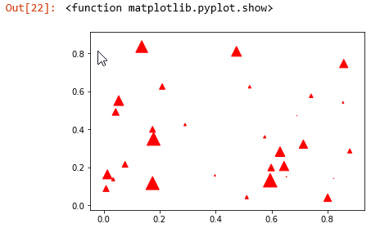
Scatter Plots
from pylab import *
N = 30
x = 0.9*rand(N)
y = 0.9*rand(N)
area = pi * (10 * rand(N))**2 # 0 to 10 point radius
scatter(x,y,s=area, marker='^', c='r')
show()
savefig('scatter_demo')

Slide 54
Odds and Ends Horizontal and Vertical Lines
hlines(y, xmin, xmax )
Draw horizontal lines at heights given by the numbers in array y
If xmin and xmax are arrays of same length as y, they give the left and right endpoints of the corresponding lines, resp.
If either is a scalar, all lines have the same endpoint, specified by it
Some keyword arguments
linewidth (or lw): line width in points
color: default ‘k’
vlines(x, ymin, ymax ) is similar but for vertical lines

Slide 55
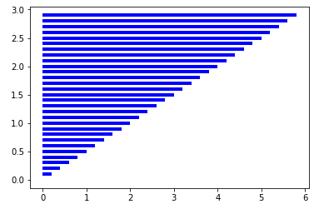
Odds and Ends Horizontal and Vertical Lines
from pylab import *
y = arange(0,3,0.1)
x = 2*y
hlines(y, 0, x, color='b', lw=4)
show()
savefig('hlines')

Slide 56
Axis Lines
axhline() draws a line on the x axis spanning the horizontal extent of the axes
axhline(y ) draws such a line parallel to the x axis at height y
Some keyword arguments
color: default ‘b’
label
linewidth in points
axvline() is similar but w.r.t. the y axis

Slide 57
Grid Lines
grid(True) function produces grid lines at the tick coordinates
grid(None) suppresses the grid
grid() toggles the presence of the grid
Some keyword arguments
color: default ‘k’
linestyle: default ‘:’
linewidth
Some Axes instance methods
get_xgridlines()
get_ygridlines()
Example:
setp(gca().get_xgridlines(), color='r')

Slide 58
Resizing the Figure
Often should make the figure wider or higher so objects aren’t cramped
Use Figure instance methods get_size_inches() and set_size_inches()
To get an array of the 2 dimensions in inches (width then height):
fig = gcf()
dsize = fig.get_size_inches()
E.g., to double the width
fig.set_size_inches( 2 * dsize[0], dsize[1] )
See the example in the SciPy Cookbook
http://www.scipy.org/Cookbook/Matplotlib/AdjustingImageSize

Slide 59
Multiple Subplots
Functions axes() and subplot() both used to create axes
subplot() used more often
subplot(numRows, numCols, plotNum)
Creates axes in a regular grid of axes numRows by numCols
plotNum becomes the current subplot
Subplots numbered top-down, left-to-right
1 is the 1st number
Commas can be omitted if all numbers are single digit
Subsequent subplot() calls must be consistent on the numbers or rows and columns

Slide 60
Multiple Subplots
subplot() returns a Subplot instance
Subplot is derived from Axes
Can call subplot() and axes() in a subplot
E.g., have multiple axes in 1 subplot
See the Tutorial for subplots sharing axis tick labels

Slide 61
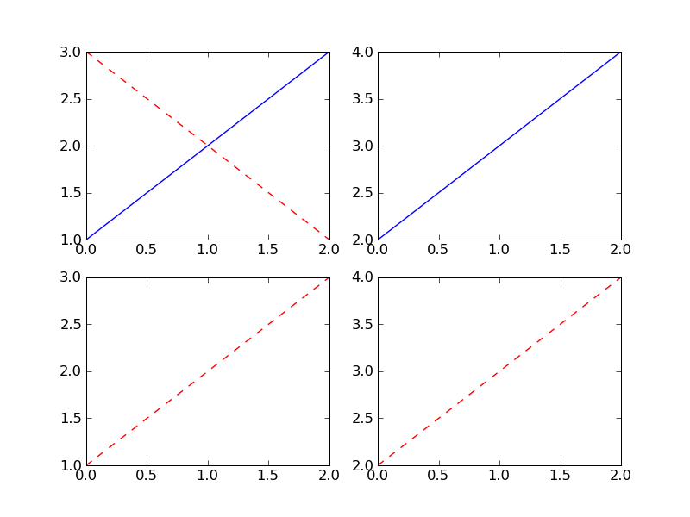
Multiple Subplots
from pylab import *
subplot(221)
plot([1,2,3])
subplot(222)
plot([2,3,4])
subplot(223)
plot([1,2,3], 'r--')
subplot(224)
plot([2,3,4], 'r--')
subplot(221)
plot([3,2,1], 'r--')
show()
savefig('subplot')

Slide 62
3D Matplotlib: mplot3d
See http://matplotlib.org/mpl_toolkits/mplot3d/tutorial.html
An Axes3D object is created like any other axes, but using the projection='3d' keyword
Create a new matplotlib.figure.Figure and add to it a new axes of type Axes3D
import matplotlib.pyplot as plt
from mpl_toolkits.mplot3d import Axes3D
fig = plt.figure()
ax = fig.add_subplot(111, projection='3d')

Slide 63
Example: 3D Line Plots
Axes3D.plot(xs, ys, *args, **kwargs)
Plot 2D or 3D data
xs, ys are the arrays of x, y coordinates of vertices
zs is the z value(s), either 1 for all points or (as array) 1 for each point
zdir gives which direction to use as z (‘x’, ‘y’ or ‘z’) when plotting a 2D set
Other arguments are passed on to plot()

Slide 64
Example: 3D Line Plots
import matplotlib as mpl
from mpl_toolkits.mplot3d import Axes3D
import numpy as np
%matplotlib notebook
import matplotlib.pyplot as plt
mpl.rcParams['legend.fontsize'] = 10
fig = plt.figure()
ax = fig.gca(projection='3d')
theta = np.linspace(-4 * np.pi, 4 * np.pi, 100)
z = np.linspace(-2, 2, 100)
r = z**2 + 1
x = r * np.sin(theta)
y = r * np.cos(theta)
ax.plot(x, y, z, \
label='parametric curve')
ax.legend()
plt.show()

Slide 65
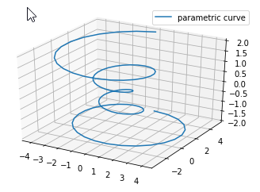
Example: 3D Line Plots

Slide 66
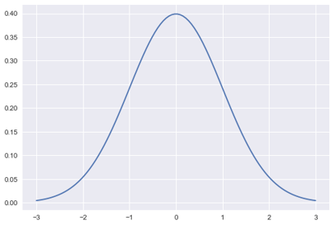
Example: 2D Normal Distribution
import matplotlib.pyplot as plt
import numpy as np
import matplotlib.mlab as mlab
import math
mu = 0
variance = 1
sigma = math.sqrt(variance)
x = np.linspace(-3, 3, 100)
plt.plot(x,mlab.normpdf(x, mu, sigma))
plt.show()

Slide 67
Example: 3D Normal Distribution
import numpy as np
import matplotlib.pyplot as plt
from scipy.stats import multivariate_normal
from mpl_toolkits.mplot3d import Axes3D
#Parameters to set
mu_x = 0
variance_x = 3
mu_y = 0
variance_y = 15
#Create grid and multivariate normal
x = np.linspace(-10,10,500)
y = np.linspace(-10,10,500)
X, Y = np.meshgrid(x,y)
pos = np.empty(X.shape + (2,))
pos[:, :, 0] = X; pos[:, :, 1] = Y
rv = multivariate_normal([mu_x, mu_y], [[variance_x, 0], [0, variance_y]])
#Make a 3D plot
fig = plt.figure()
ax = fig.gca(projection='3d')
ax.plot_surface(X, Y, rv.pdf(pos),cmap='viridis',linewidth=0)
ax.set_xlabel('X axis')
ax.set_ylabel('Y axis')
ax.set_zlabel('Z axis')
plt.show()

Slide 68
Example: 3D Plot
from mpl_toolkits import mplot3d
import numpy as np
import matplotlib.pyplot as plt
%matplotlib inline
%matplotlib notebook
plt.rcParams["figure.figsize"] = 12.8, 9.6
ax = plt.axes(projection='3d')
import numpy as np
def LoG(x, y, sigma):
temp = (x ** 2 + y ** 2) / (2 * sigma ** 2)
return -1 / (np.pi * sigma ** 4) * (1 - temp) * np.exp(-temp)
N = 49
half_N = N // 2
X2, Y2 = np.meshgrid(range(N), range(N))
Z2 = -LoG(X2 - half_N, Y2 - half_N, sigma=8)
X1 = np.reshape(X2, -1)
Y1 = np.reshape(Y2, -1)
Z1 = np.reshape(Z2, -1)
#wireframe plot
ax = plt.axes(projection='3d')
ax.plot_wireframe(X2, Y2, Z2, color='r')

Slide 69
Example: 3D Plot
#Surface plot
ax = plt.axes(projection='3d')
ax.plot_surface(X2, Y2, Z2, cmap='jet')
#Wirefram plot with color
from matplotlib import cm
# Normalize the colors based on Z value
norm = plt.Normalize(Z2.min(), Z2.max())
colors = cm.jet(norm(Z2))
ax = plt.axes(projection='3d')
surf = ax.plot_surface(X2, Y2, Z2, facecolors=colors, shade=False)
surf.set_facecolor((0,0,0,0))
#Scatter plot
ax = plt.axes(projection='3d')
ax.scatter(X1, Y1, Z1, c=Z1, cmap='BrBG', linewidth=1)
#Contour plot
ax = plt.axes(projection=’3d’)
ax.contour3D(X2, Y2, Z2, 55, cmap=’twilight_shifted’)
#Trisurf plot
ax = plt.axes(projection='3d')
ax.plot_trisurf(X1, Y1, Z1, cmap='twilight_shifted')

Slide 70
Example: 3D Plot
#Surface plot
ax = plt.axes(projection='3d')
ax.plot_surface(X2, Y2, Z2, cmap='jet')
#Wirefram plot with color
from matplotlib import cm
# Normalize the colors based on Z value
norm = plt.Normalize(Z2.min(), Z2.max())
colors = cm.jet(norm(Z2))
ax = plt.axes(projection='3d')
surf = ax.plot_surface(X2, Y2, Z2, facecolors=colors, shade=False)
surf.set_facecolor((0,0,0,0))
#Scatter plot
ax = plt.axes(projection='3d')
ax.scatter(X1, Y1, Z1, c=Z1, cmap='BrBG', linewidth=1)
#Contour plot
ax = plt.axes(projection=’3d’)
ax.contour3D(X2, Y2, Z2, 55, cmap=’twilight_shifted’)
#Trisurf plot
ax = plt.axes(projection='3d')
ax.plot_trisurf(X1, Y1, Z1, cmap='twilight_shifted')

Slide 71
Example: 3D Tea Pot
import numpy as np
def read_obj(filename):
triangles = []
vertices = []
with open(filename) as file:
for line in file:
components = line.strip(' \n').split(' ')
if components[0] == "f": # face data
# e.g. "f 1/1/1/ 2/2/2 3/3/3 4/4/4 ..."
indices = list(map(lambda c: int(c.split('/')[0]) - 1, components[1:]))
for i in range(0, len(indices) - 2):
triangles.append(indices[i: i+3])
elif components[0] == "v": # vertex data
# e.g. "v 30.2180 89.5757 -76.8089"
vertex = list(map(lambda c: float(c), components[1:]))
vertices.append(vertex)
vertices, triangles = read_obj("teapot.obj")
x = vertices[:,0]
y = vertices[:,1]
z = vertices[:,2]
ax = plt.axes(projection='3d')
ax.set_xlim([-3, 3])
ax.set_ylim([-3, 3])
ax.set_zlim([0, 3])
ax.plot_trisurf(x, z, triangles, y, shade=True, color='white')

Slide 72
Example: 3D Normal Distribution
# List of geometric vertices
v 0.123 0.234 0.345
v ...
# Polygonal face element
f 1 2 3
f ...
import numpy as np
def read_obj(filename):
triangles = []
vertices = []
with open(filename) as file:
for line in file:
components = line.strip(' \n').split(' ')
if components[0] == "f": # face data
# e.g. "f 1/1/1/ 2/2/2 3/3/3 4/4/4 ..."
indices = list(map(lambda c: int(c.split('/')[0]) - 1, components[1:]))
for i in range(0, len(indices) - 2):
triangles.append(indices[i: i+3])
elif components[0] == "v": # vertex data
# e.g. "v 30.2180 89.5757 -76.8089"
vertex = list(map(lambda c: float(c), components[1:]))
vertices.append(vertex)

Slide 73
Animation: The Old Way
To take an animated plot and turn it into a movie,
save a series of image files (e.g., PNG) and
use an external tool to convert them to a movie
Can use mencoder, part of the mplayer suite
See http://www.mplayerhq.hu/design7/news.html
Can download binaries for Windows
Or use ImageMagick’s convert (“the Swiss army knife of image tools”)
See http://www.imagemagick.org/script/convert.php

Slide 74
Matplotlib Animation
Matplotlib Animation Tutorial
http://jakevdp.github.com/blog/2012/08/18/matplotlib-animation-tutorial/
Matplotlib animation documentation
http://matplotlib.org/api/animation_api.html
Matplotlib animation examples
http://matplotlib.org/examples/animation/
Official and good, but documentation limited to meager program comments
The tutorial (above) goes through several of these
Alias http://matplotlib.sourceforge.net/examples/animation/index.html
This replaces the Cookbook examples
http://www.scipy.org/Cookbook/Matplotlib/Animations

